Slide 1
Radio Teletype

Slide 2

Session Aims
To understand how telemetry data is transmitted over radio teletype
To receive RTTY telemetry from your payload
You will need (per pair):
1 x payload
1 x Radio Scanner
1 x Audio cable
Tablet / Laptop

Slide 3
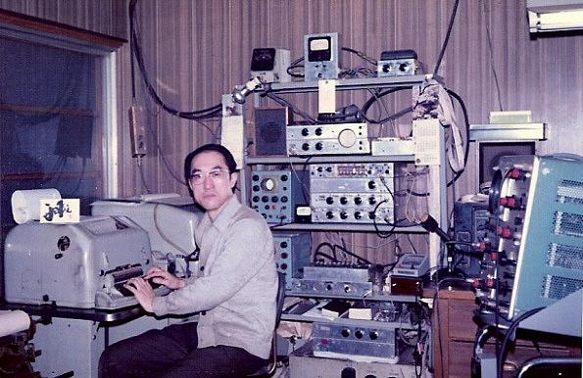
Radio TeleType

Slide 4
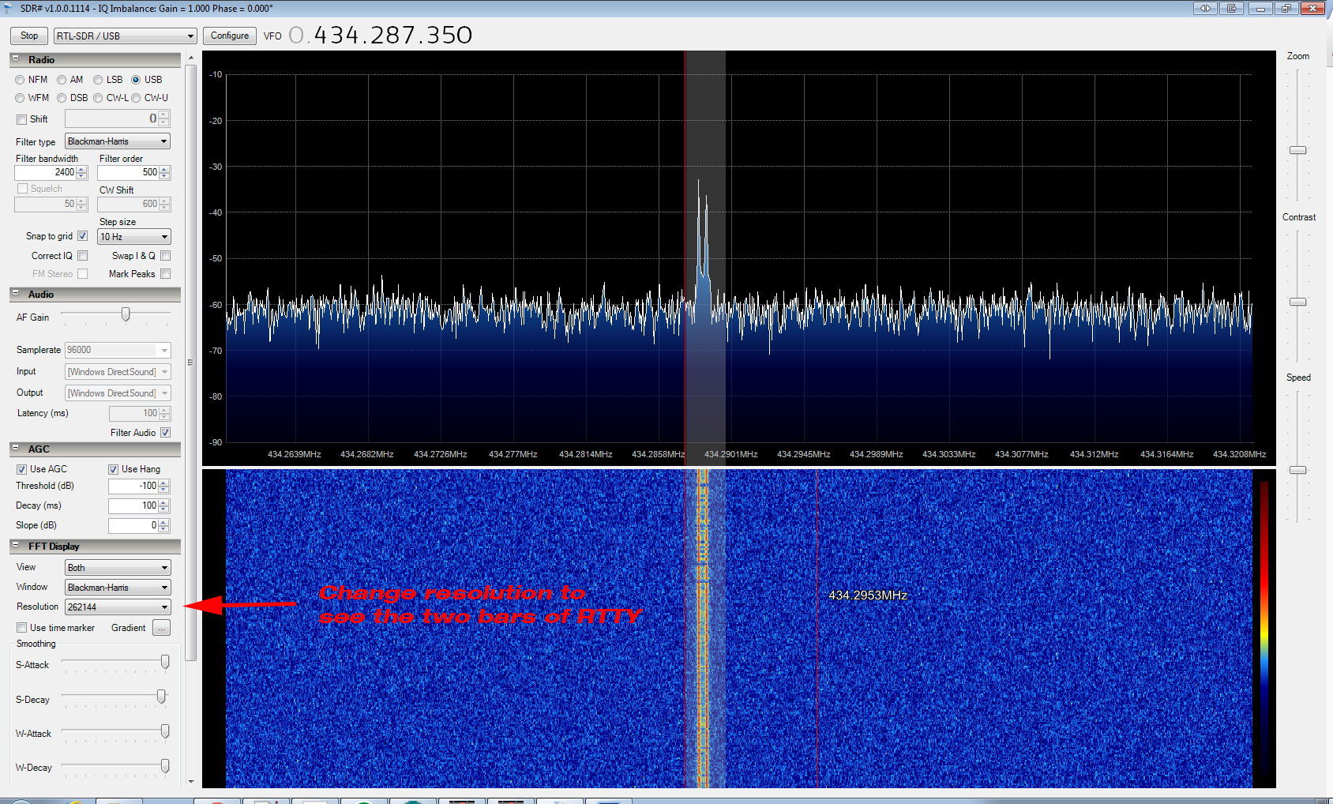
RTTY Spectrum Plot

Slide 5
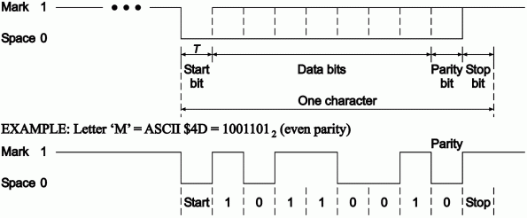
Byte Format

Slide 6
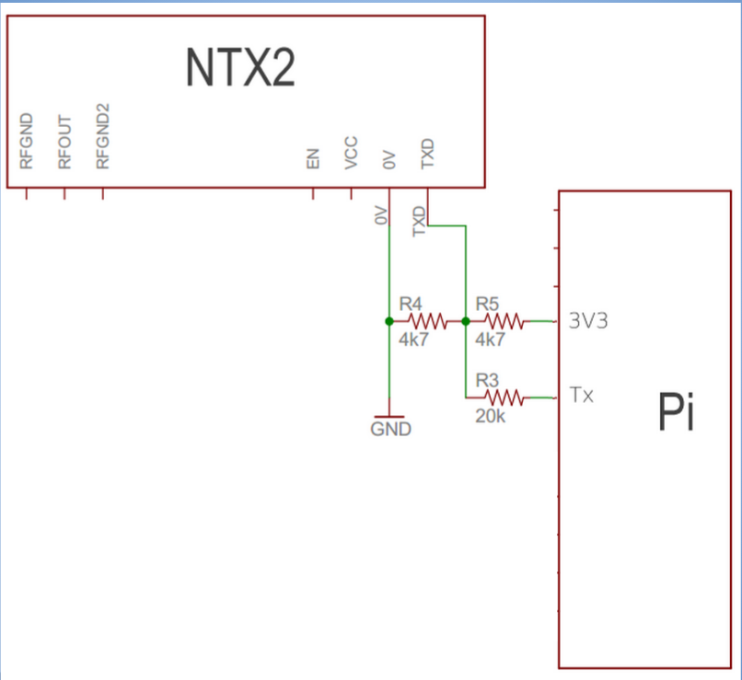
NTX2 FM Radio

Slide 7
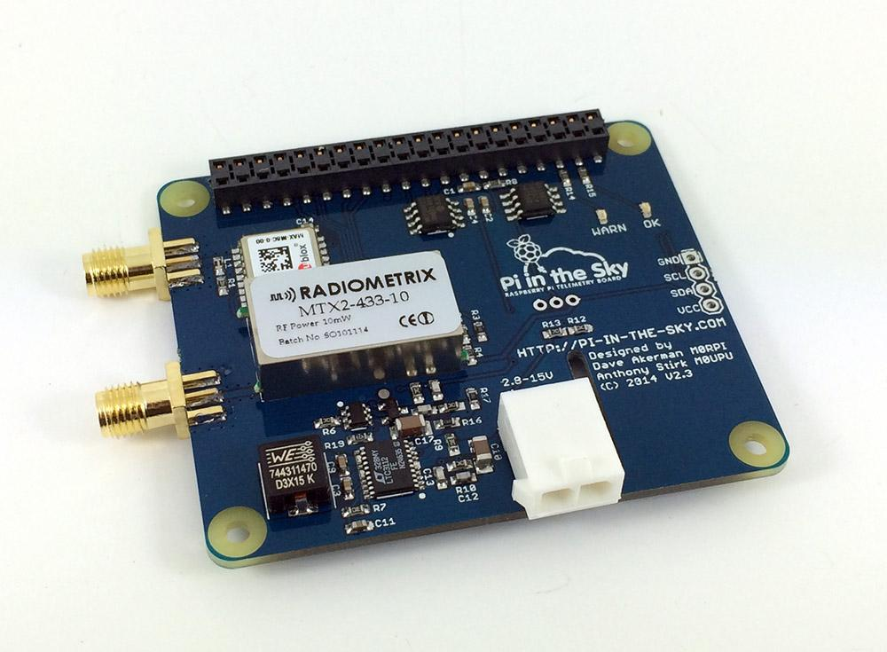
Tracker

Slide 8

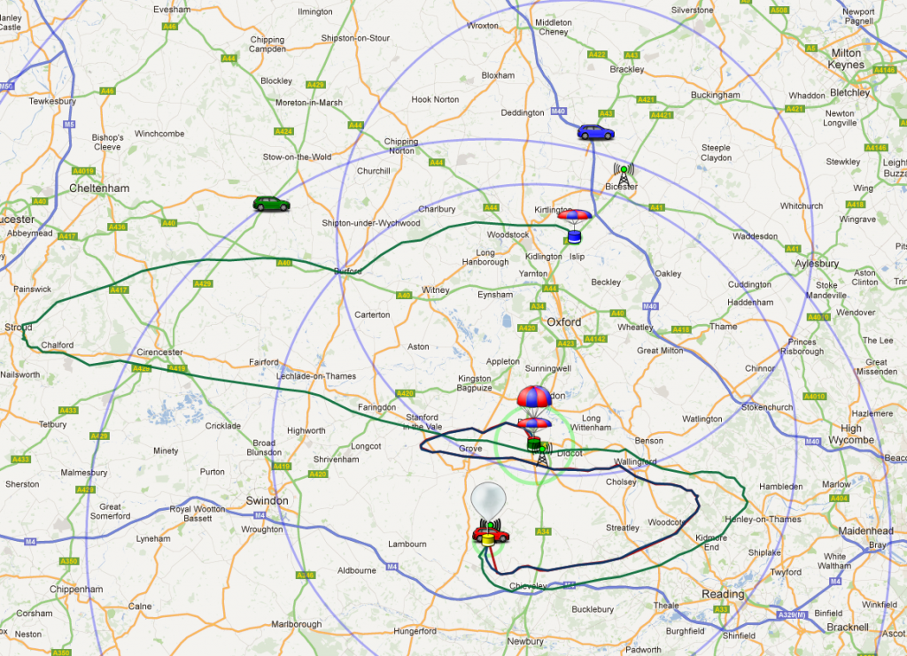
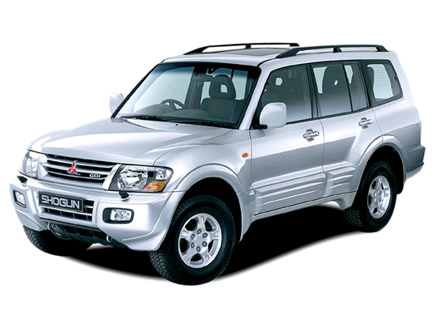
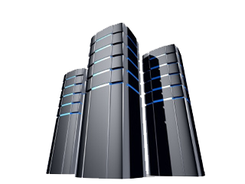

Distributed Tracking System

Slide 9
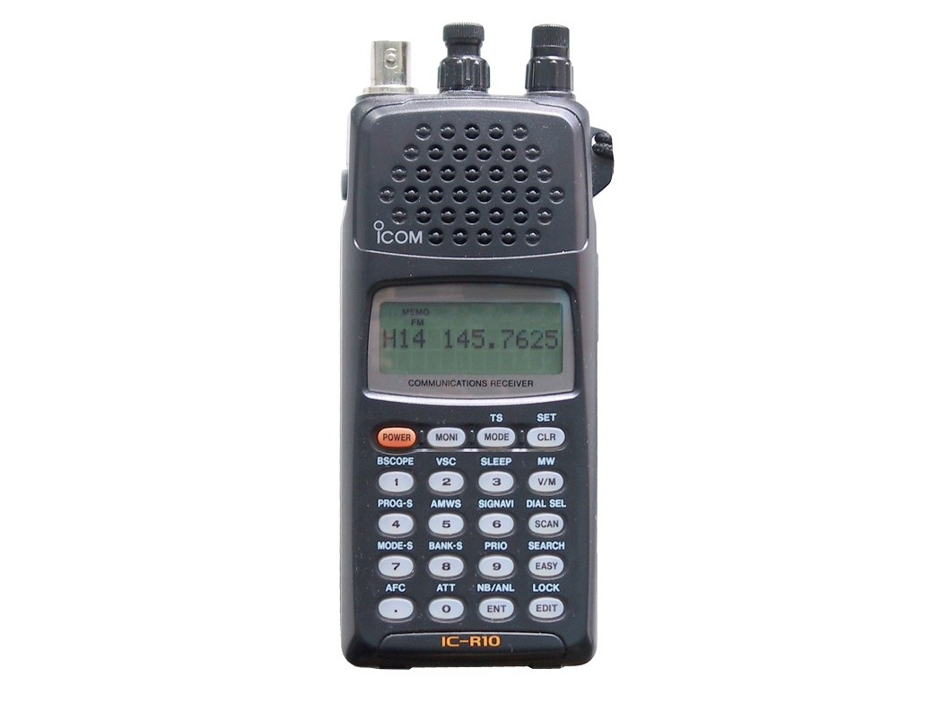
Receiver

Slide 10
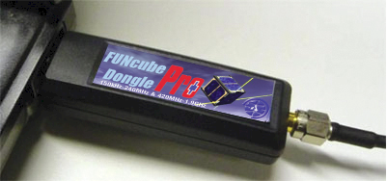
Software Defined Radio

Slide 11
Decoding On A PC
dl-fldigi

Slide 12
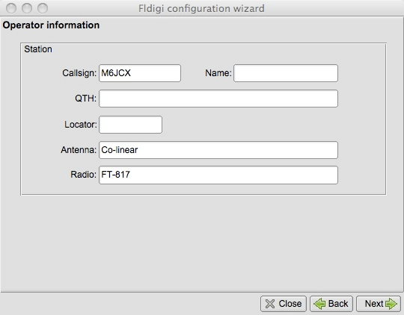
dl-fldigi Configuration

Slide 13
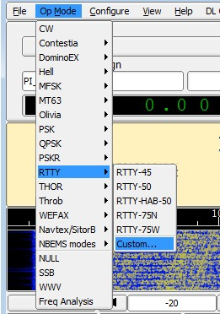
RTTY Decoder

Slide 14
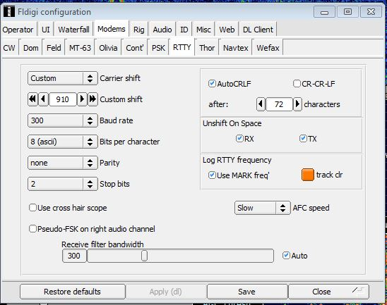
RTTY Settings

Slide 15
RTTY Settings for Pi In The Sky
payload=PISKY
frequency=434.540
baud=300
payload - Shows on the map, so you know which balloon is yours. Also used on the live image map so you know which images are from your flight. Preferably keep to no more than 6 characters because that is the limit for the image side.
frequency - Just like radio stations, each balloon needs its own frequency. Generally balloon frequencies should be separated by at least 10kHz for RTTY and 50kHz for LoRa.
baud - Controls the speed of data transmission. Generally 50 baud is used for data only, or 300 baud if you are also sending images. For the serial setting used by the PITS software, 300 baud is equivalent to 27 characters per second - very slow!

Slide 16
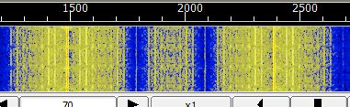
Waterfall

Slide 17
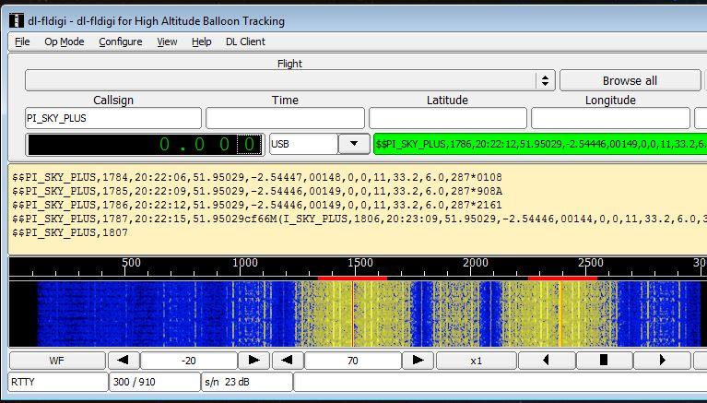
Decoding

Slide 18
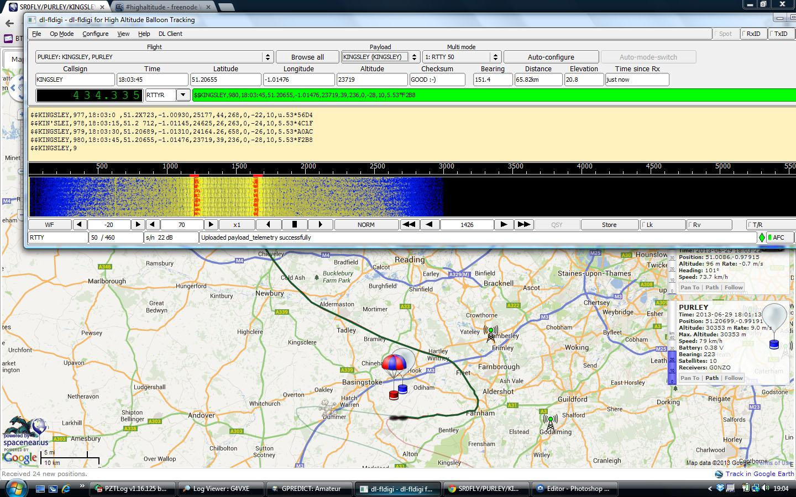
Decoding and Mapping

